Slide 1
Hibernate Types and Session Configuration

Slide 2
Session configuration
Configuration cf = new Configuration() .addFile(“Person.hbm.xml") .addFile(“Employee.hbm.xml");
Configuration cfg = new Configuration() .addClass(org.hibernate.auction.Person.class) .addClass(org.hibernate.auction.Employee.class);

Slide 3
A Configuration is intended as a configuration-time object, to be discarded once a SessionFactory is built
Properties props = new Properties(); Configuration cfg = new Configuration() .addClass(org.hibernate.auction.Person.class) .addClass(org.hibernate.auction.Employee.class) .setProperties(props);

Slide 4
SessionFactory
SessionFactory sessions = cfg.buildSessionFactory();
Session session = sessions.openSession();

Slide 5
User provided JDBC Connection
java.sql.Connection conn = datasource.getConnection(); Session session = sessions.openSession(conn);
hibernate.connection.datasource = java:/comp/env/jdbc/MyDB
hibernate.transaction.factory_class = \ net.sf.hibernate.transaction.JTATransactionFactory
hibernate.transaction.manager_lookup_class = \ net.sf.hibernate.transaction.JBossTransactionManagerLookup
hibernate.dialect = \ net.sf.hibernate.dialect.PointBaseSQLDialect

Slide 6
Hibernate properties
hibernate.dialect
hibernate.default_schema
hibernate.session_factory_name(JNDI)
hibernate.jdbc.fetch_size
hibernate.jdbc.batch_size
hibernate.jdbc.use_scrollable_resultset
hibernate.cglib.use_reflection_optimizer
hibernate.connection.isolation
hibernate.connection.<propertyName>
hibernate.connection.provider_class
hibernate.cache.provider_class
hibernate.cache.use_query_cache
hibernate.transaction.factory_class
jta.UserTransaction
hibernate.transaction.manager_lookup_class
hibernate.show_sql
hibernate.hbm2ddl.auto

Slide 7
SQL Dialect
net.sf.hibernate.dialect.DB2Dialect
net.sf.hibernate.dialect.DB2400Dialect
net.sf.hibernate.dialect.DB2390Dialect
net.sf.hibernate.dialect.PostgreSQLDialect
net.sf.hibernate.dialect.MySQLDialect
net.sf.hibernate.dialect.OracleDialect
net.sf.hibernate.dialect.Oracle9Dialect
net.sf.hibernate.dialect.SybaseDialect
net.sf.hibernate.dialect.SybaseAnywhereDialect
net.sf.hibernate.dialect.SQLServerDialect
net.sf.hibernate.dialect.SAPDBDialect
net.sf.hibernate.dialect.InformixDialect
net.sf.hibernate.dialect.HSQLDialect
net.sf.hibernate.dialect.IngresDialect
net.sf.hibernate.dialect.ProgressDialect
net.sf.hibernate.dialect.MckoiDialect
net.sf.hibernate.dialect.InterbaseDialect
net.sf.hibernate.dialect.PointbaseDialect
net.sf.hibernate.dialect.FrontbaseDialect
net.sf.hibernate.dialect.FirebirdDialect

Slide 8
Transactions
net.sf.hibernate.transaction.JDBCTransactionFactory
net.sf.hibernate.transaction.JTATransactionFactory

Slide 9
Transaction Managers supported by Hibernate
net.sf.hibernate.transaction.JBossTransactionManagerLookup
net.sf.hibernate.transaction.WeblogicTransactionManagerLookup
net.sf.hibernate.transaction.WebSphereTransactionManagerLookup
net.sf.hibernate.transaction.OrionTransactionManagerLookup
net.sf.hibernate.transaction.ResinTransactionManagerLookup
net.sf.hibernate.transaction.JOTMTransactionManagerLookup
net.sf.hibernate.transaction.JOnASTransactionManagerLookup
net.sf.hibernate.transaction.JRun4TransactionManagerLookup
net.sf.hibernate.transaction.BESTransactionManagerLookup

Slide 10
Persistent classes
Implement hashCode() and equals method()

Slide 11
Object LifeCycle
Defined by Lifecycle interface
Implement this interface in the persistence class
public boolean onSave(Session s) throws CallbackException;
public boolean onUpdate(Session s) throws CallbackException;
public boolean onDelete(Session s) throws CallbackException;
public void onLoad(Session s, Serializable id);

Slide 12
LifeCycle
onSave - called just before the object is saved or inserted
onUpdate - called just before an object is updated
onDelete - called just before an object is deleted
onLoad - called just after an object is loaded

Slide 13
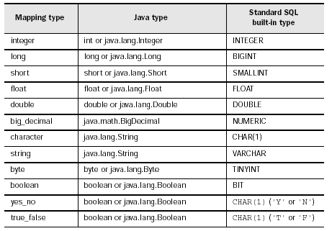
Hibernate Types

Slide 14
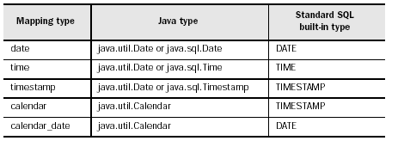
Date and Time Mapping

Slide 15
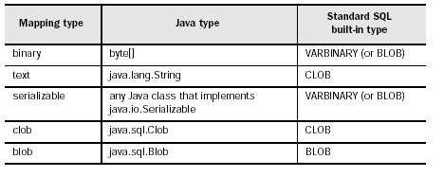
Large Object Mapping

Slide 16
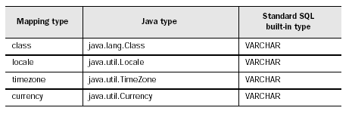
JDK Class Mapping types

Slide 17
Custom User type
<property name="initialPrice“ column="INITIAL_PRICE"
type=“training.MonetaryAmountUserType"/>

Slide 18
CompositeUserType
<property name="initialPrice“ type=“training.MonetaryAmountCompositeUserType">
<column name="INITIAL_PRICE"/>
<column name="INITIAL_PRICE_CURRENCY"/>
</property>
from Item i
where i.initialPrice.value > 100.0
and i.initialPrice.currency = 'AUD'

Slide 19
Enumerated Type
session.createQuery("from Comment c where c.rating = :rating");
q.setParameter("rating",
Rating.LOW,
Hibernate.custom(RatingUserType.class));

